Slide 1



Smash with Bash
[Scripting language]
Presenter
Mohammad Anees Alam
Notes:
1.7.2013
1
‹#›

Slide 2
Topics for today!
1
Intro of Bash: What & Why
2
Structure of Bash
3
File Handling
4
String manipulation
5
DevOps role with Bash
6
Practical Activity
Notes:
1.7.2013
2
‹#›

Slide 3

What is Bash?
Unix Shell
1
Bash is a Unix shell (CLI) and command language which interprets & executes the commands provided by users.
Automation
2
Commonly used for automation and scripting.
Command-Line
3
Allows interaction with the operating system.
Notes:
1.7.2013
3
‹#›

Slide 4
Bash Scripting
A sequence of Linux commands in a file to automate tasks, simply referred to as script!
Prevents manual intervention and saves human efforts.
Can be used with advanced programming logics for decision-oriented tasks.
Loops
Conditionals
Functions
Variables
for, while
if, else
Custom functions to encapsulate commands.
Storing and manipulating data.
Notes:
1.7.2013
4
‹#›

Slide 5
Why use bash scripts over Linux??
Key Differences:
Linux Commands:
1
Individual commands that you execute "one at a time" in the terminal.
Consumes a lot of time to complete one whole task.
Not suitable for complex tasks.
Example - ls, cat, vim, touch, mkdir etc;
Bash Scripts:
2
A sequence of Linux commands and Bash scripting elements (loops, conditionals, functions, etc.) written in a script file to automate tasks.
Consumes less time frame to complete a group of tasks at once.
Highly recommended for complex tasks.
Example - Git setup in local environment.
Notes:
1.7.2013
5
‹#›

Slide 6

Bash vs Cron
Cron
Bash
Automation
Task scheduler for running scripts at intervals.
Writes scripts to execute multiple Linux commands.
Automates repetitive tasks and handles errors.
    We can utilize bash to the full extent if we bring in cron jobs on board, together these can form an automation task.
Example -
    Bash script: To write a script that can back up our system automatically.
    Cron: Set a time interval for that back up script to avoid over storage usage.
    Automation Task: Building a script to automatically initiate a back-up for your data every night at 11 PM.
Notes:
1.7.2013
6
‹#›

Slide 7





Use-cases of Bash
File Management
Automating Tasks
Remote Commands
Server Admin
Notes:
1.7.2013
7
‹#›

Slide 8





Structure of Bash Script
Shebang
#!/bin/bash tells the system to use Bash.
Variables
Assign variables using = sign "without spaces".
Commands
Instructions that Bash will execute.
Comments
Lines that start with # are ignored.
Notes:
1.7.2013
8
‹#›

Slide 9
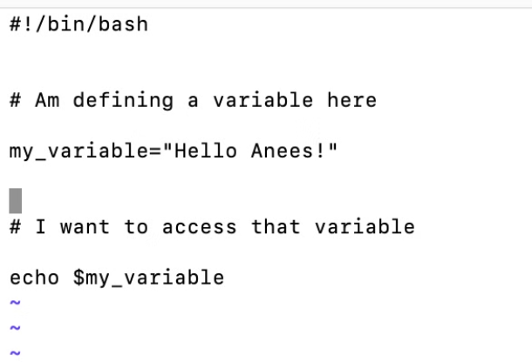

Let's try to run a simple script!!
Output
INPUT
    Create a file with extension ".sh"
    Use vim to enter editor mode, begin with shebang line, so shell knows it's a bash script.
    (which bash —> To verify where bash is located.)
    After saving the <fileName>.sh, u need to give permissions to execute that file using :
    "chmod +x <fileName>.sh"
    To run your script: ./<fileName>.sh
Notes:
1.7.2013
9
‹#›

Slide 10

File Handling Commands
cp
1
Copies files or directories.
rm
2
Deletes files.
touch
3
Creates empty file.
echo
4
Prints output.
variable
5
Assign a value - Set once, use multiple times.
Notes:
1.7.2013
10
‹#›

Slide 11
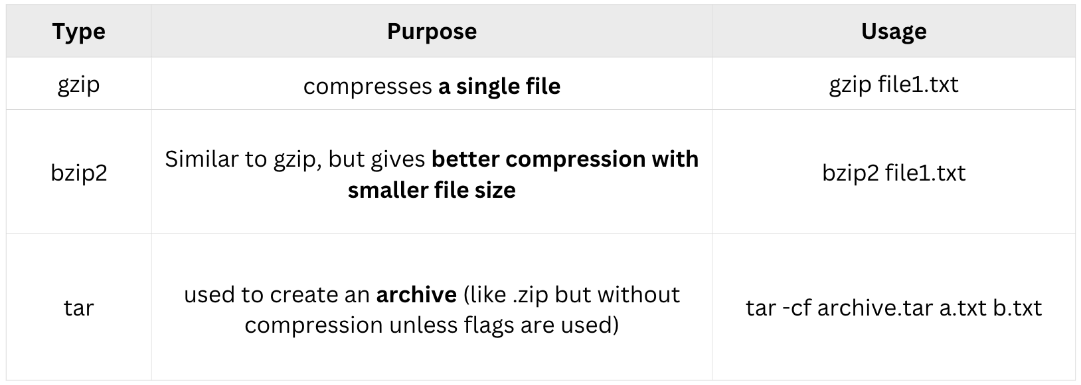
File Compression

Slide 12
File Compression with tar
-f
Specifies the name of the archive.
-c
Creates a new archive.
-z
Compresses the archive using gzip.
Notes:
1.7.2013
11
‹#›

Slide 13
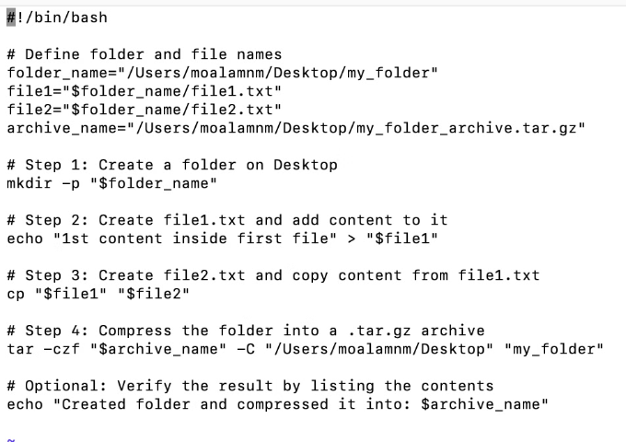
Hands-on Activity: File Handling
Let's create a script wherein a folder is created with a designated name.
Inside the folder, a file (file1) is generated with content and copy that to new file2.
Once both files are created with content, compress the folder and print the successful message at the end.
Output
Input script
Notes:
1.7.2013
12
‹#›

Slide 14
String Manipulation
awk
grep
sed
    Deals with structured data.
Search for patterns.
    Stream editor.
    Displays data as per our ask from a CSV/Excel files.
Displays data as per our ask from a text file.
    Deals with content within the files to search & replace, insert or delete.
    Example: awk '{ print $1 }' file.txt
Example: grep "blue" Variations.txt
# Prints the first column of the file
    Example: sed 's/old-text/new-text/' filename
# Searches for 'pattern' in the file
# Replaces 'old-text' with 'new-text'
Notes:
1.7.2013
13
‹#›

Slide 15
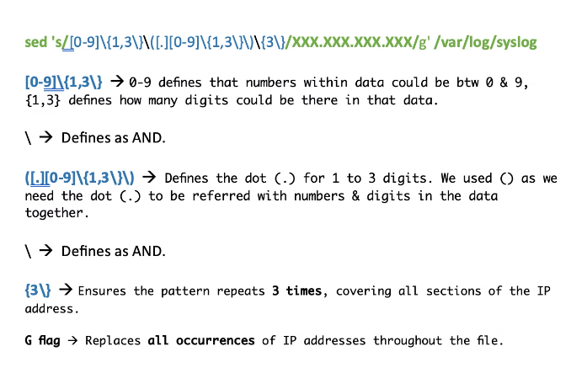
Use cases in DevOps
Example: Log File Analysis for Monitoring System Health.
Using grep to find error logs from specific path:
    To find all lines containing the word ERROR in a log file and extract the relevant information.
    grep "ERROR" /var/log/syslog
Using awk to extract specific fields from the logs:
    When you want to extract useful information from grep result (timestamp, error type, etc.).
    grep "ERROR" /var/log/syslog | awk '{print $1, $2, $3, $5, $6}'
Using sed to remove sensitive info from logs before sharing:
    To share log files with other team members while masking sensitive data, you can use sed to replace that (e.g., IP addresses, usernames).
    sed 's/[0-9]\{1,3\}\([.][0-9]\{1,3\}\)\{3\}/XXX.XXX.XXX.XXX/g' /var/log/syslog
    Replaces all occurrences of IP addresses throughout the file.
Notes:
1.7.2013
14
‹#›

Slide 16
Use cases in SED
Flag / Command | Usage (Example) | What it does
s (Substitute) | sed 's/http/https/' file.txt | Replaces the first occurrence of the specified pattern in each line.
g (Global) | sed 's/http/https/g' file.txt | Replaces all occurrences of the specified pattern in each line. Used with the s command.
-i (In-place Edit) | sed -i 's/8080/9090/g' config.txt | Modifies the original file directly without creating a separate output file.
d (Delete) | sed '/ERROR/d' logfile.txt | Deletes all lines that match the specified pattern. Useful for removing unwanted log or configuration entries.
a (Append) | sed '/server/a timeout=30' config.txt | Appends a new line after the line matching the specified pattern.
c (Change) | sed '/timeout/c timeout=60' config.txt | Replaces the entire matching line with the specified text. Useful for updating configuration values.
Notes:
1.7.2013
14
‹#›

Slide 17
Automation Scenarios
As a DevOps engineer, you will be working on building various automation tasks with bash as follows:
Server Setup and Configuration
System Monitoring and Health Checks
Task Automation
1
2
3
Software Installation and Updates
Version Control and Deployment
Cloud Infrastructure Management
4
5
6
Security and Compliance
Backup and Disaster Recovery
Logging and Troubleshooting
7
8
9
Notes:
1.7.2013
15
‹#›

Slide 18
Assignment:
Create & run a script that automates package updates in your system.
    Create a new script: vim update_packages.sh
    Write the Update Commands inside your script:
#!/bin/bash
echo "Updating package list..."
sudo apt update
echo "Upgrading packages..."
sudo apt upgrade -y
echo "Cleaning up..."
sudo apt autoremove -y
Note: For CentOS/RHEL-based systems, replace the above commands with: sudo yum
    Make the Script Executable before running: chmod +x update_packages.sh
    Run the script to automatically update the packages: ./update_packages.sh
    Verify the Updates: Check if the system has been updated by running:
    sudo apt list --upgradable — or — sudo yum check-update —> As per your Linux env.
Notes:
1.7.2013
16
‹#›

Slide 19

Conclusion
    Bash fundamentals: Bash is a Unix shell used for command-line interfaces, automation, and scripting. It allows you to combine commands and logic to automate tasks, like system backups and server management.
    Structure of Bash Script: A Bash script starts with a shebang (#!/bin/bash), followed by commands, variables, and comments. Variables are assigned without spaces, and comments begin with #.
    File Handling: Bash provides commands like cp (copy), rm (remove), touch (create file), and echo (output text) for file operations.
    File Compression: The tar command is used to create compressed archives, often with the -czf option for gzip compression.
    String Manipulation (Awk, Sed, Grep): awk processes text line by line, sed manipulates text streams, and grep searches for patterns. These tools are essential for text parsing and pattern matching.
    Automation Scenarios: Bash scripts automate tasks like server configuration, software installation, backups, system health checks, and more.
Notes:
1.7.2013
17
‹#›

